Slide 1
GeoLocation
HTML5 Series
Notes:
MSN is almost put to bed. Maxim is mostly down.
We need to get back to being developers who are learning new things all the time and share that knowledge with each other.

Slide 2
geolocation object
navigator.geolocation
methods
getCurrentPosition()
watchPosition()
clearWatch()
Notes:
I intentionally chose probably the smallest new thing in HTML5 but more will be coming.
So without further delay, meet the geolocation object
The specification requires browser asks user before returning location data.
Part of the navigator object
Contains only 3 methods and no properties

Slide 3
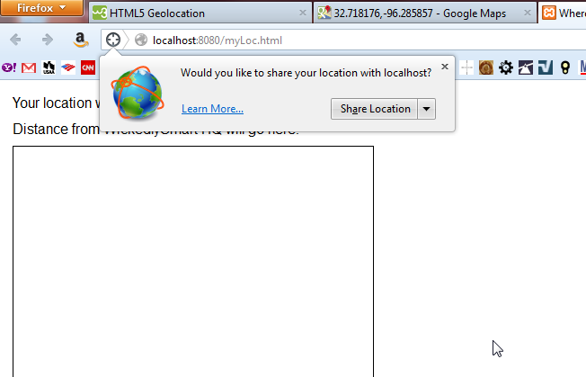
Firefox Request

Slide 4
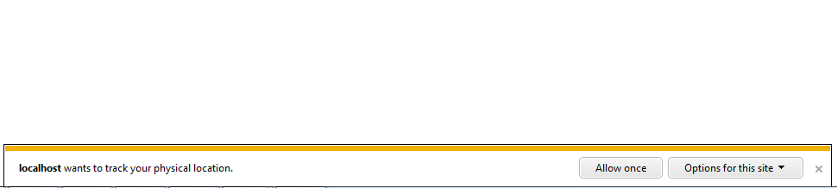
Internet Explorer 9 Request
Notes:
Displays at the bottom of the browser window

Slide 5
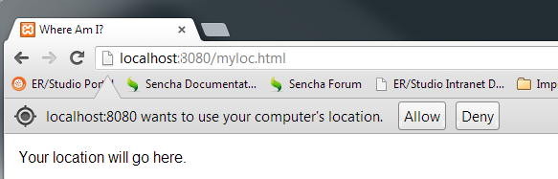
Chrome Request

Slide 6
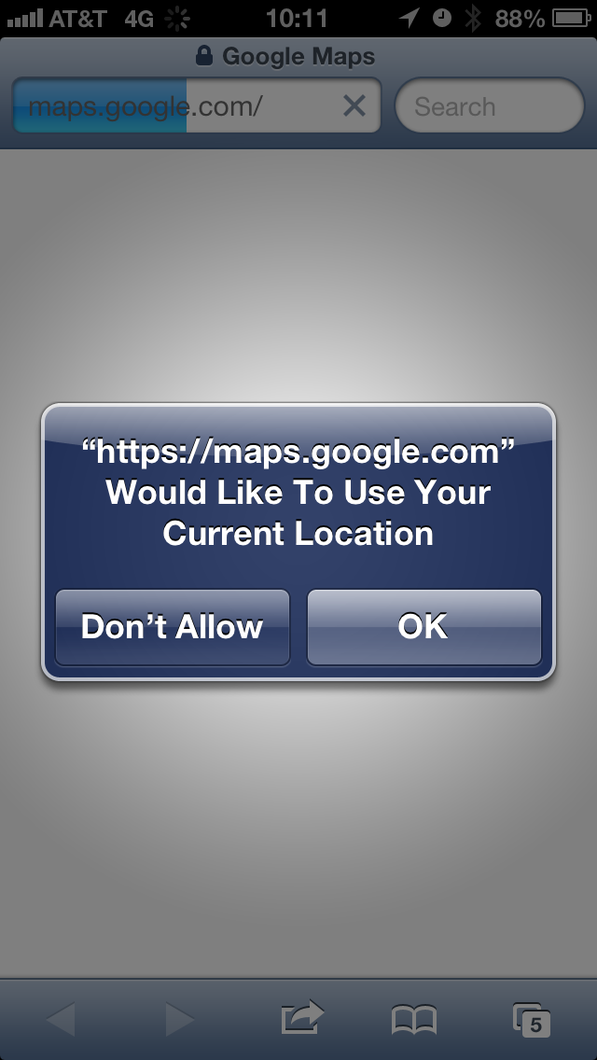
iPhone Safari

Slide 7
getCurrentPosition()
Takes
successHandler (passed a position object)
failureHandler (passed an error object)
positionOptions
enableHighAccuracy: boolean
timeout: numeric (milliseconds)
maximumAge: numeric
Notes:
getCurrentPosition takes 3 arguments, only the first is required
First 2 are handlers to call on success and failure
Third is a positionOptions object
enableHighAccuracy is a browser hint and different browsers use it differently.
Timeout is how long in milliseconds before the request for location times out, infinite by default.
maximumAge is how long the browsers location can be without re-checking it before returning it. 0 is default.

Slide 8
Code Sample
window.onload = function(){
if(nagivator.geolocation){
navigator.geolocation.getCurrentPosition(displayLocation, displayError);
} else {
alert(“Oops, no geolocation support…”);
}
}
function displayLocation(position){
}
function displayError(error){
}

Slide 9
getCurrentPosition() successHandler
Position Object
coords
latitude
longitude
accuracy (in meters of the location within 95% confidence)
altitude (if available)
altitudeAccuracy (if available)
heading (if available)
speed (if available)
timestamp
Notes:
Passed a position object to the success handler which contains a coords object and timestamp
Latitude, longitude, and accuracy are always there. If available items may come from a high end cell phone, tablet, something with an actual GPS chipset in it.
SHOW http://geolocation.netne.net/myLoc.html
Why is it showing Hartford???
To answer that, we should know how it gets our location

Slide 10
How does it get my location?
Newer smartphones have a GPS chip
Computer IP address
Cell phone triangulation
WiFi positioning
Notes:
GPS
Needs view of the sky to work best
More satellites locked == better accuracy
Takes a bit to get a location
Can be hard on device batteries
Most likely candidate to return altitude, speed, and heading data
Computer IP Address
Uses external database to map IP to physical location
Reliable to city or neighborhood level generally
Cell Phone triangulation
The more towers, the more accurate
Accuracy suffer in the middle of nowhere with one cell tower
WiFi Positioning
Works indoors and is very accurate
Pretty much have to be sitting still

Slide 11
Success Handler Sample
function displayLocation(position){
var latitude = position.coords.latitude;
var longitude = position.coords.longitude;
alert(“You are at Lat: “ + latitude + “ Long: “ + longitude
}
Notes:
Absolutely basic success handler

Slide 12
getCurrentPosition() failureHandler
Error Object
code
1: Permission denied by user
2: Position is not available
3: Request timed out
PERMISSION_DENIED
POSITION_UNAVAILABLE
TIMEOUT
Notes:
Code is an property, the other 3 are constants that contain what the code is for that error (the constant)

Slide 13
Error Handler Sample
function showError(error){ switch(error.code){ case error.PERMISSION_DENIED: msg = "User denied" break; case error.POSITION_UNAVAILABLE: msg = "Location information is unavailable." break; case error.TIMEOUT: msg = "The request timed out." break; case error.UNKNOWN_ERROR: msg = "An unknown error occurred." break; }
alert(msg) }
Notes:
Basic error handler

Slide 14
watchPosition()
takes
successHandler (passed a position object)
failureHandler (passed an error object)
returns
watchId
passes coordinates or error object to appropriate handler
Notes:
Same basic method as getCurrentPosition() except this calls the method when the location changes
Is basically a recursive function that calls over and over as location changes
Can be used to mark paths in Google maps using markers followed

Slide 15
clearWatch()
takes
watchId returned from watchPosition()

Slide 16
watchPosition() Sample
var watchId = null;
window.onload = function(){
if(nagivator.geolocation){
// Once we set this, the success handler gets called when location changes
watchId = navigator.geolocation.watchPosition(displayLocation);
} else {
alert(“Oops, no geolocation support…”);
}
}
function displayLocation(position){
clearWatch(watchId);
alert(“We are done with you”);
}

Slide 17
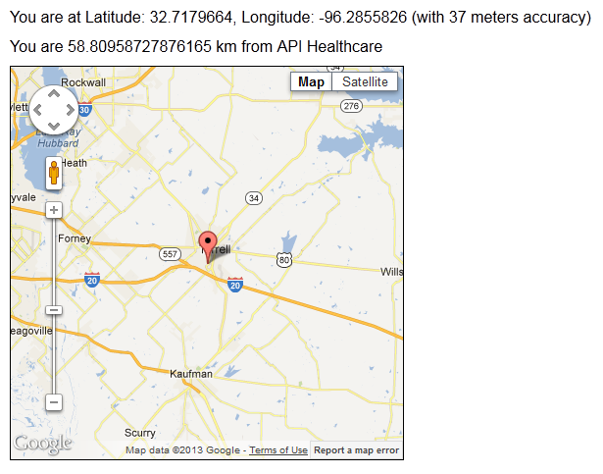
Notes:
SHOW SAMPLE CODE
Other things we can do with Google Maps API
can alter or add your own controls
access services like directions, distance, street view
add overlays like heat maps, traffic, construction, accidents

Slide 18
So how can we use this?
Notes:
Mobile devices showing temps how to get to client locations

Slide 19
What’s next for the HTML5 Series?
JSONP
Canvas
Video
Web Storage
Web Workers
New HTML Elements
New CSS
Notes:
JSONP not really HTML5 only but some of us may not be familiar, useful because this can be done cross domain where XMLHttpRequest cant be cross domain
Canvas for drawing
Video, which can tied into canvas objects for some interesting behavior
Web Storage, which we tend to call local storage, spec calls it web storage
Web workers
New HTML elements, move towards semantic elements
New CSS
None of this are specifically going to be in this order

